Slide 1
Visualization with Genome Browsers
Session 5
T6: Making the most of cis-regulatory annotations for genome-scale analysis
Gabriela A. Merino - Louisse Paola Mirabueno
Senior Bioinformatician, Ensembl Regulation, EMBL-EBI
Outreach Officer,
Ensembl Outreach,
EMBL-EBI
03/09/2026

Slide 2
Hands-on

Slide 3
Assignment
Start a clean IGV session.
Select/load the correct reference genome (GRCh38/GRCm39/mm10)
Load user-defined regions, signal tracks, peak tracks and regulatory elements annotation for the indicated epigenome:
Human, HCT116 (male, 48 years old).
Mouse, Forebrain E13.5.
Rename, reorder, and color tracks by evidence layer, using the following color scale:
ATAC-seq
DNase-seq
H3K4me3
Set adequate display options for signal and annotation tracks.
Inspect the custom regions:
Elements where CRE annotations are concordant
One conflict between annotation or evidence layers.
One missing-context example.
Locus:
GRCh38, chr8:127,361,923-127,770,942
GRCm39/mm39, chr6:6,740,753-6,891,103; GRCm38/mm10 chr6:6,740,753-6,891,103
Save an IGV session, screenshot, or launchable view.
H3K27ac
H3K4me1
Custom regions

Slide 4
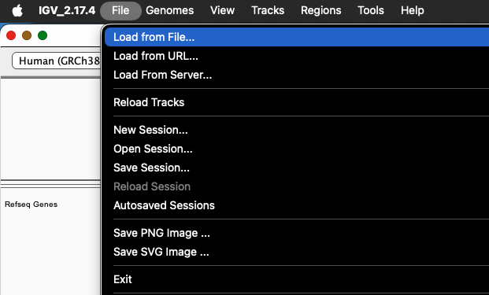
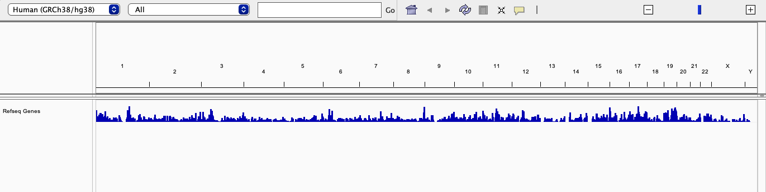
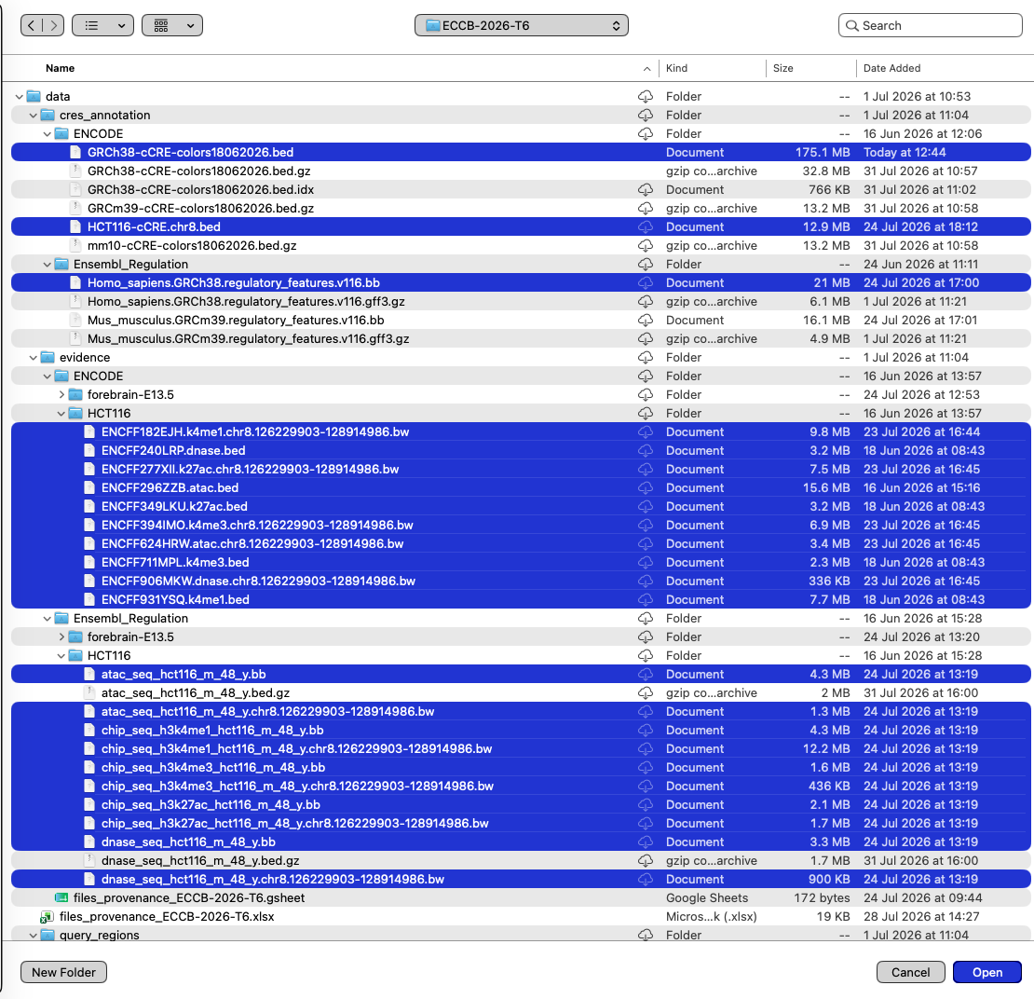
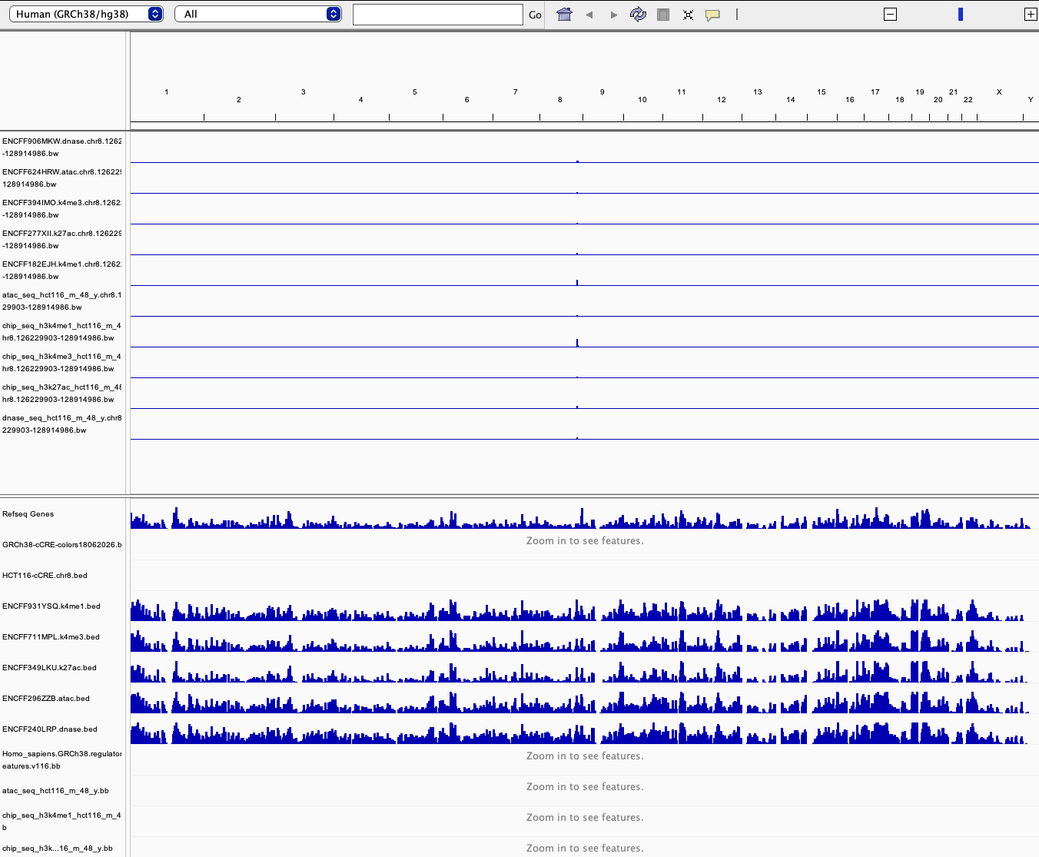
Assignment: Human

Slide 5
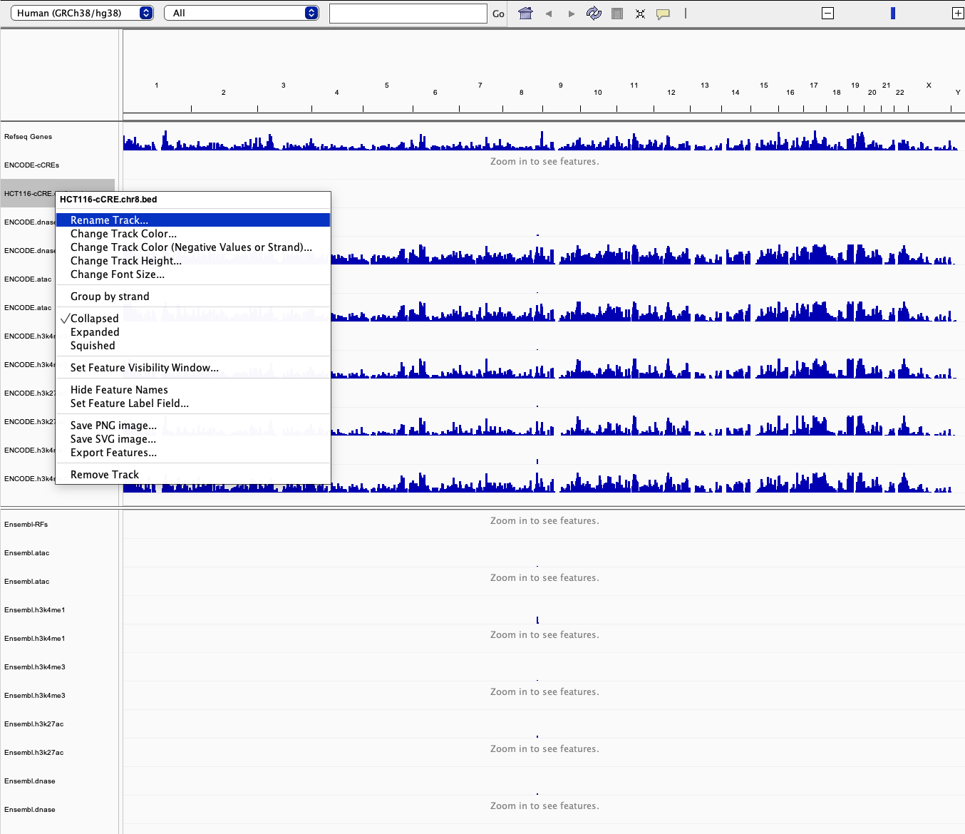
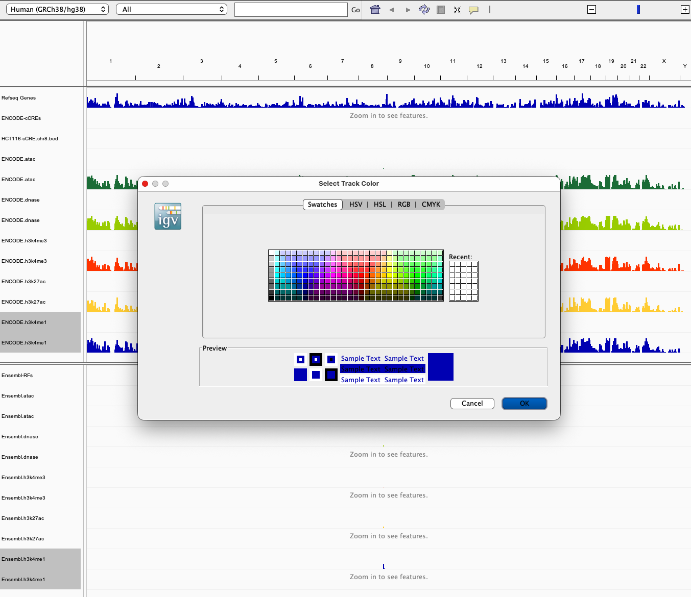
Assignment: Human

Slide 6
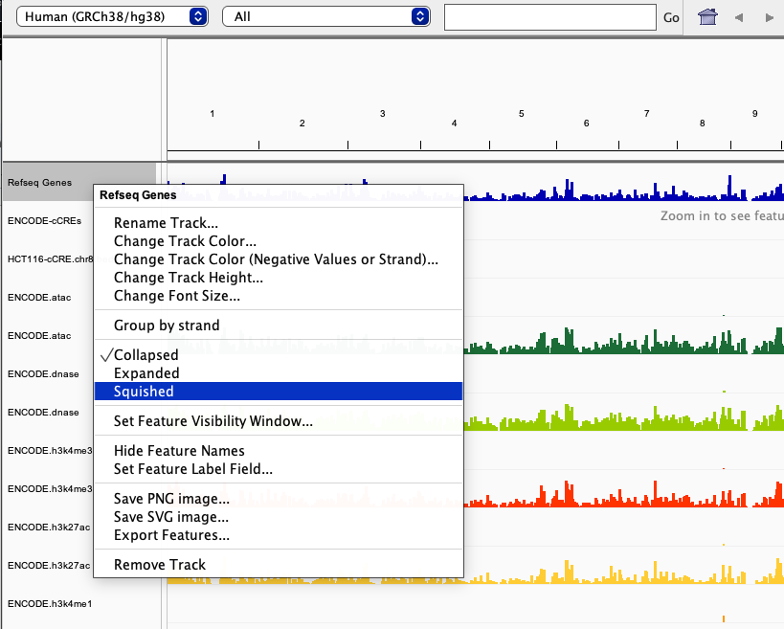
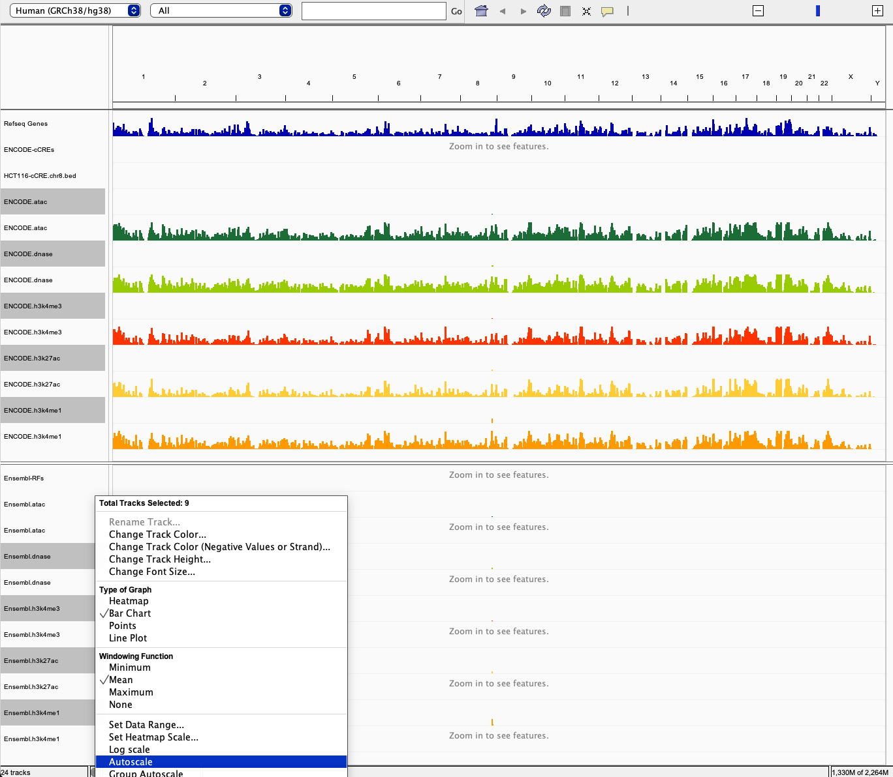
Assignment: Human

Slide 7
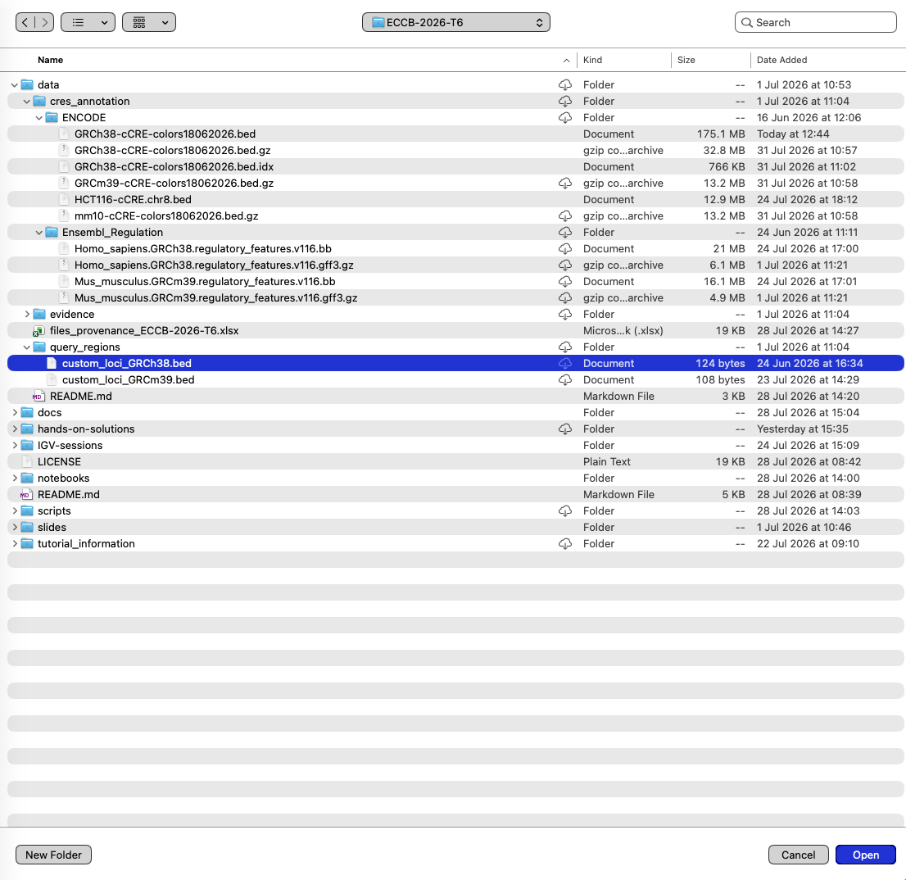
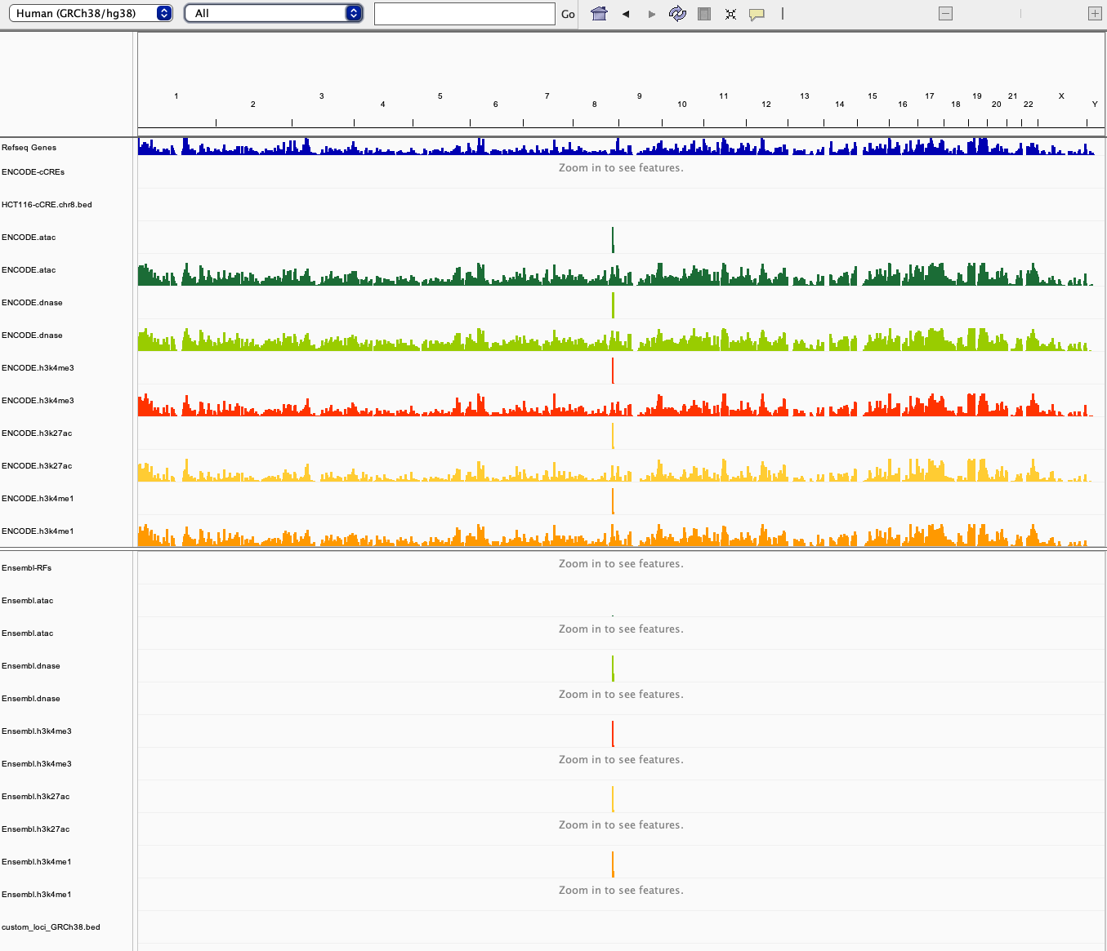
Assignment: Human

Slide 8
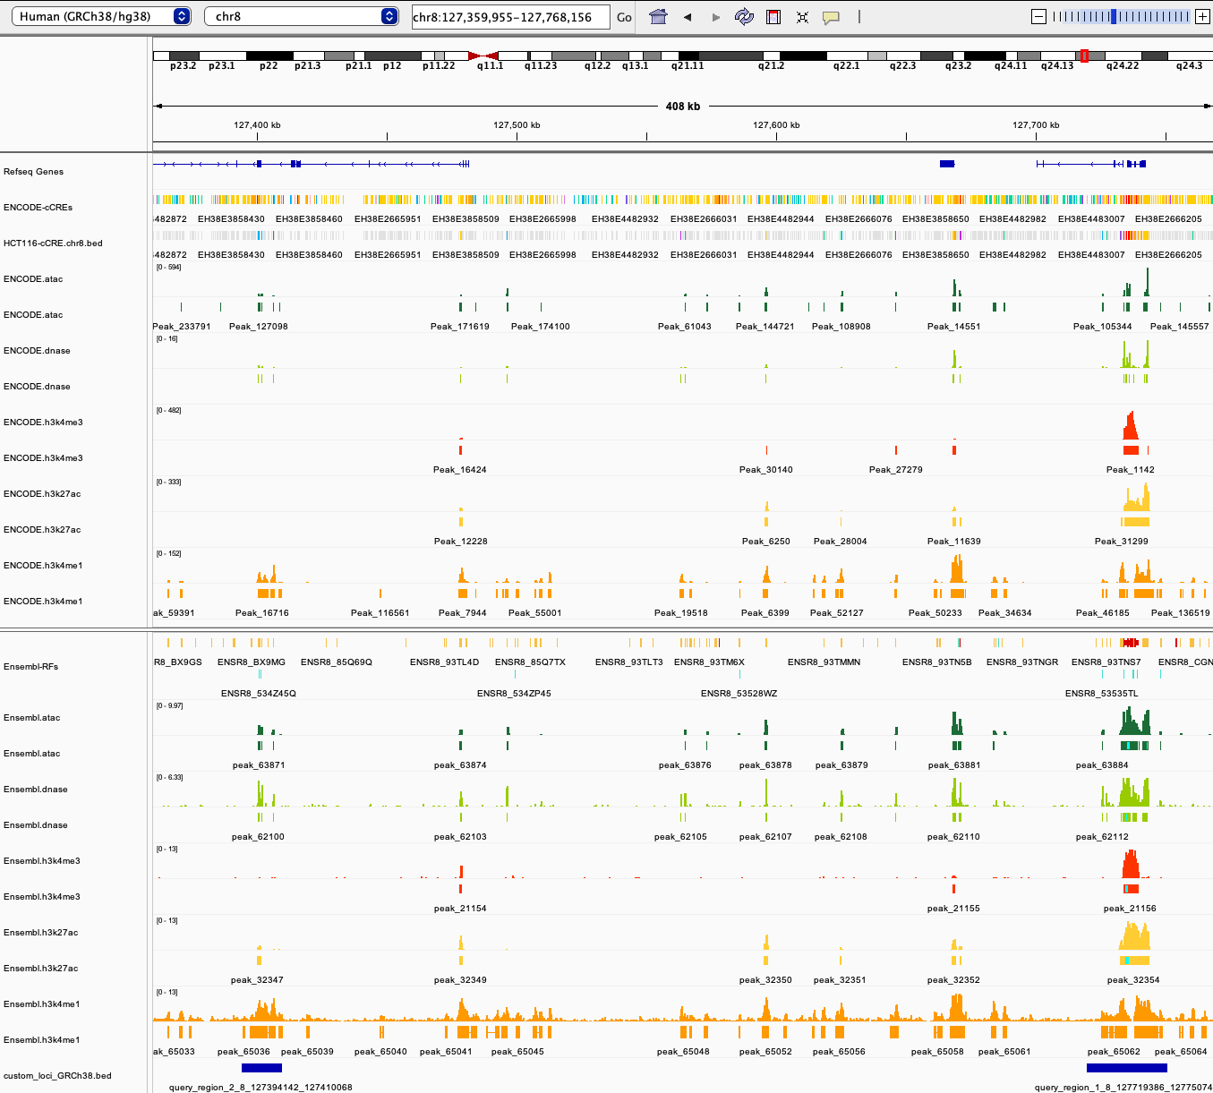
Assignment: Human
GRCh38, chr8:127,361,923-127,770,942

Slide 9
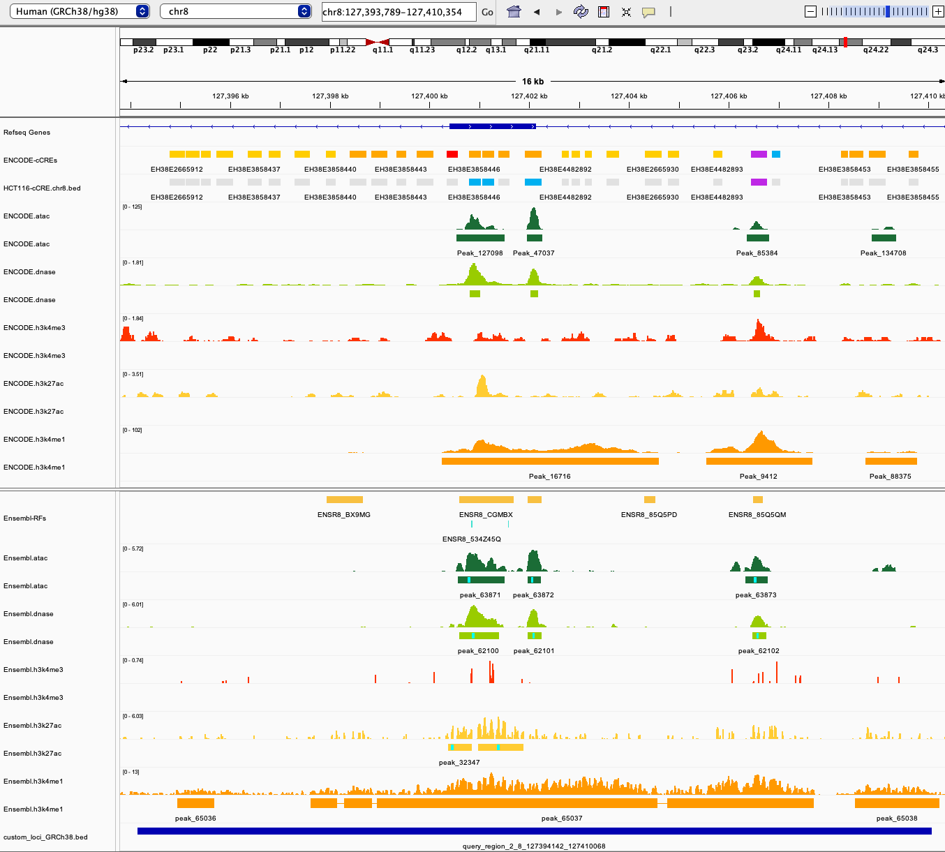
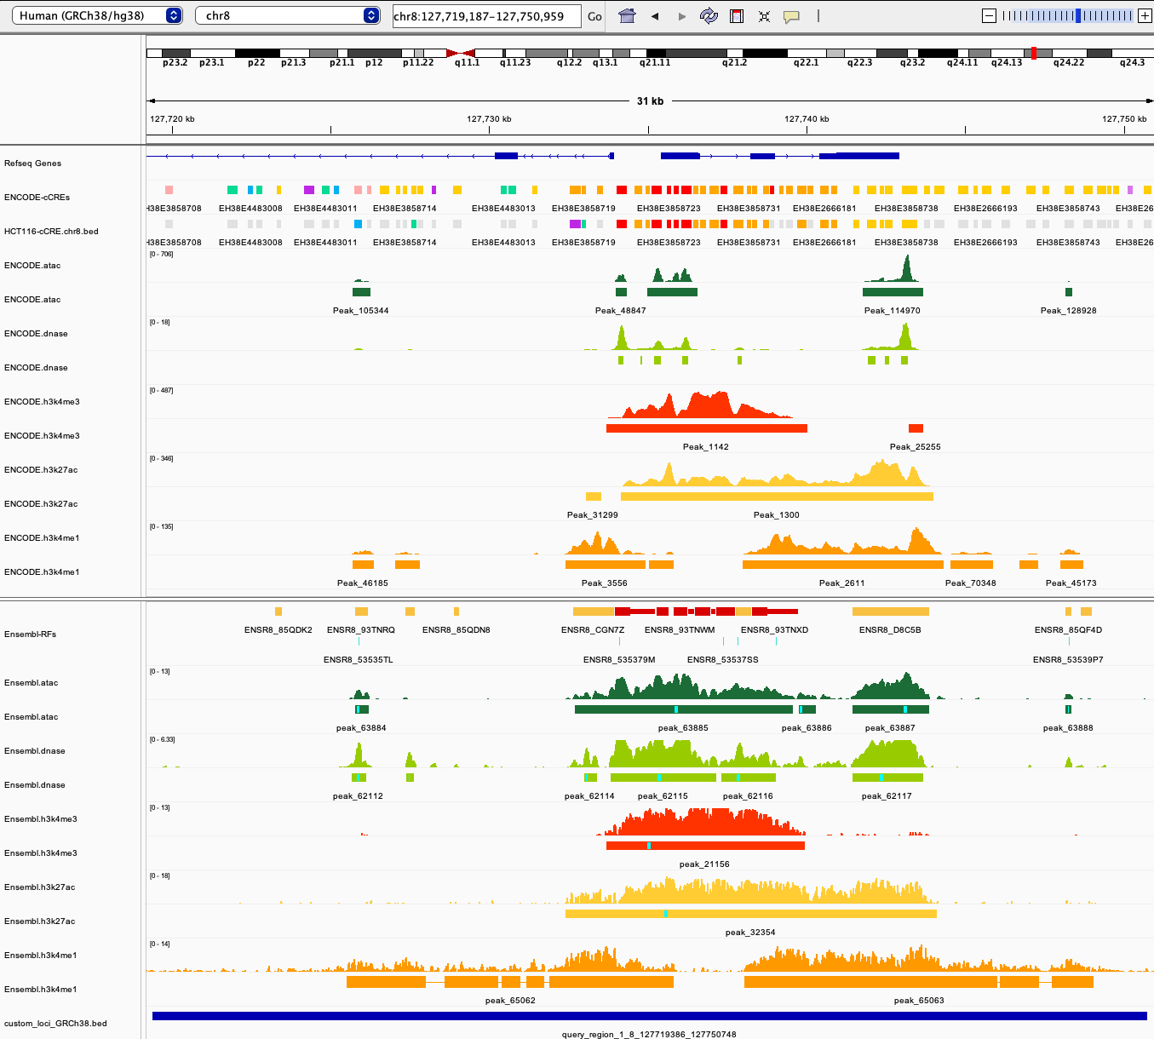
Assignment: Human
GRCh38, chr8:127,361,923-127,770,942

Slide 10
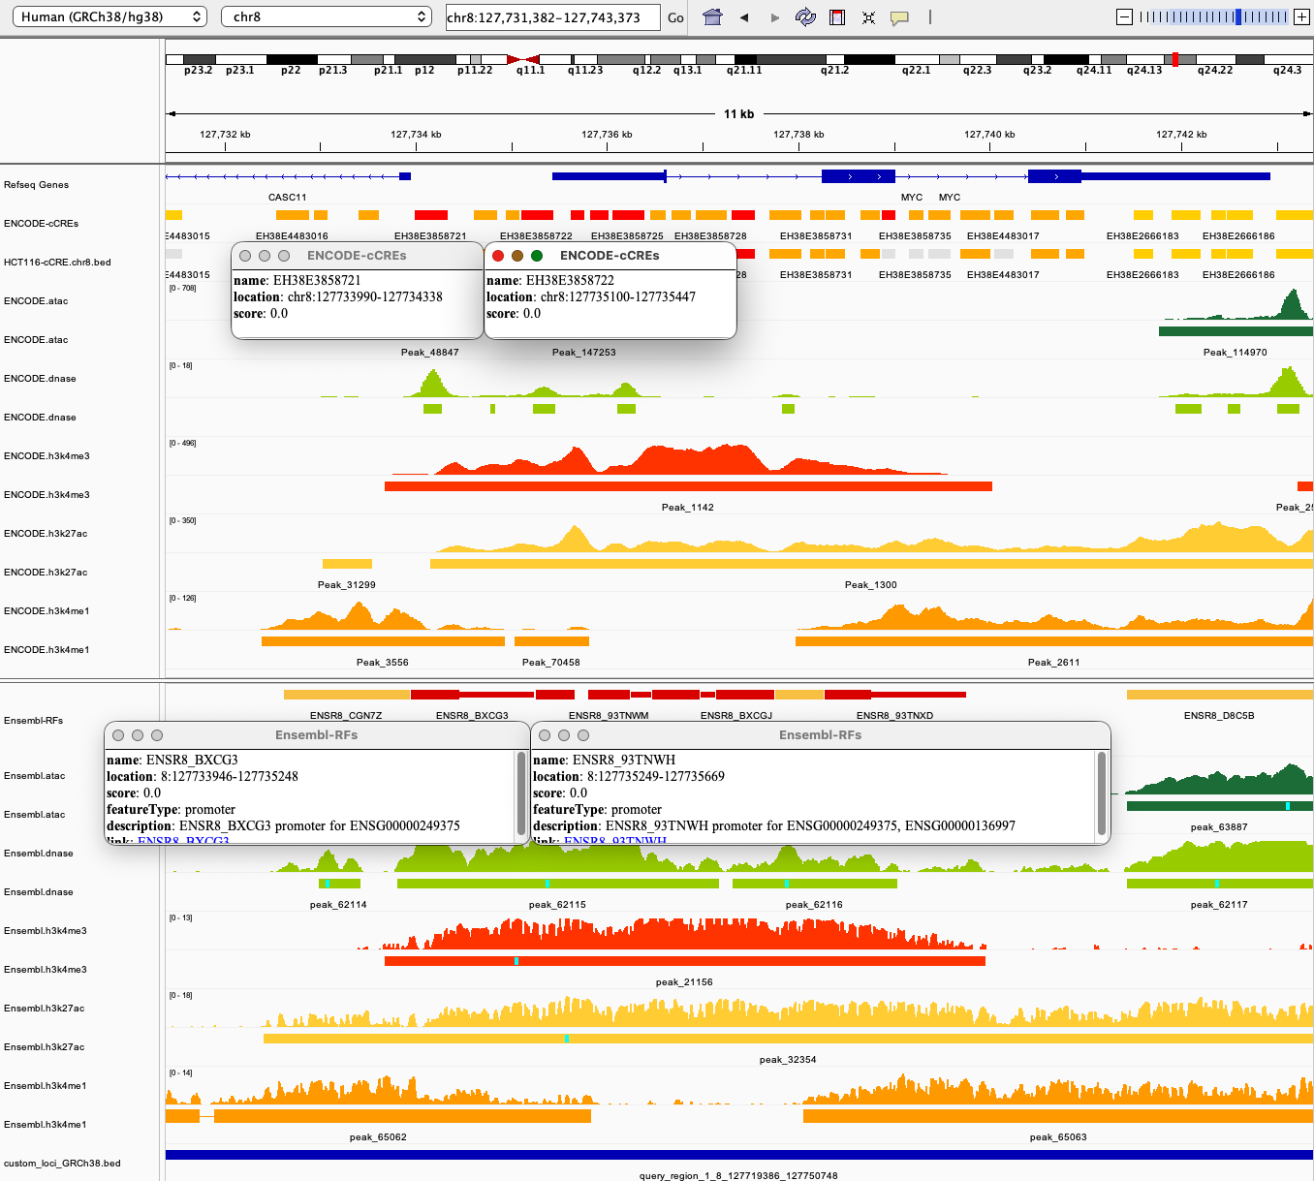
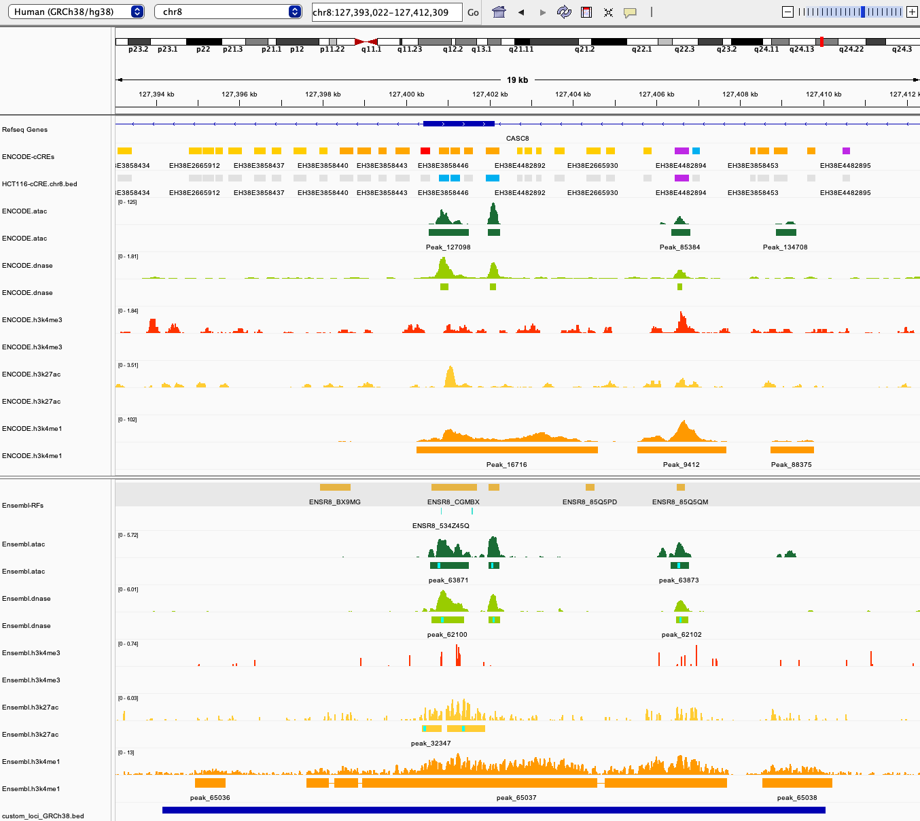
Elements where CRE annotations are concordant

Slide 11
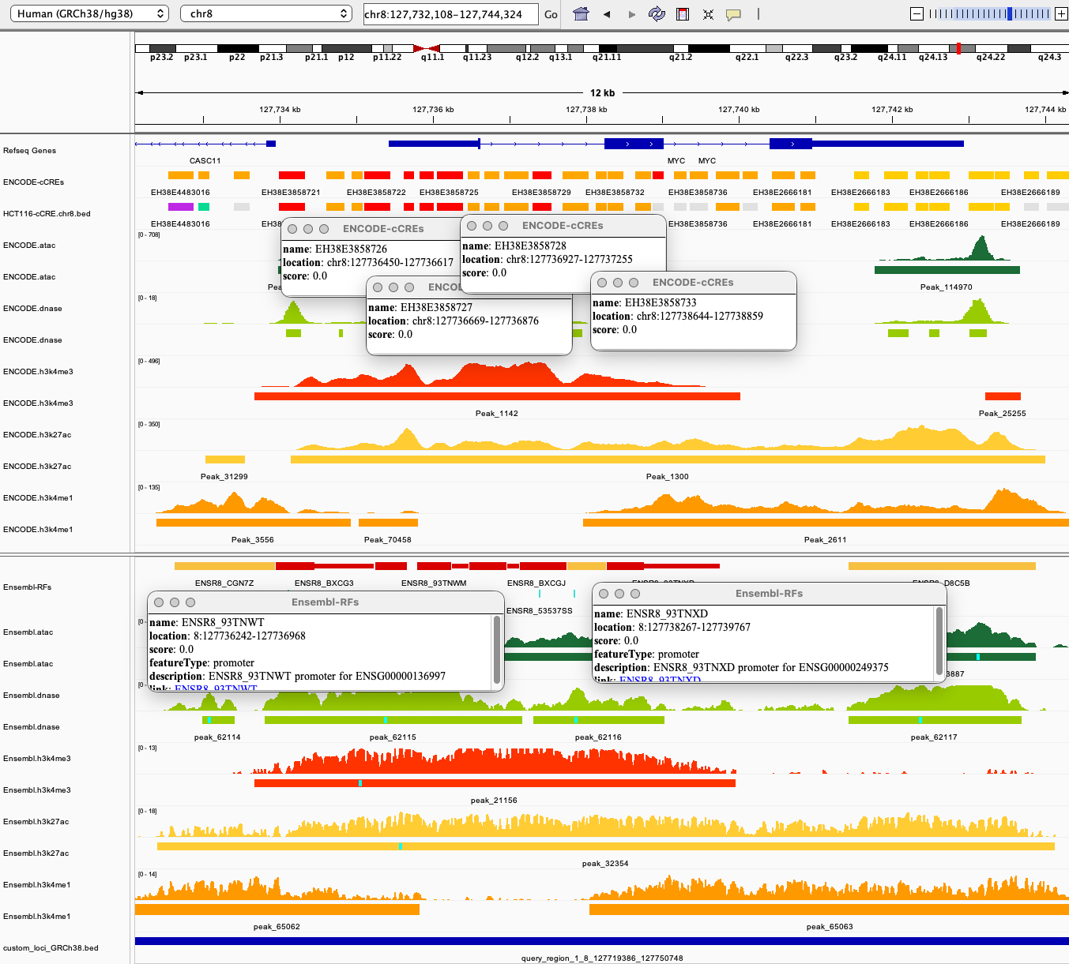
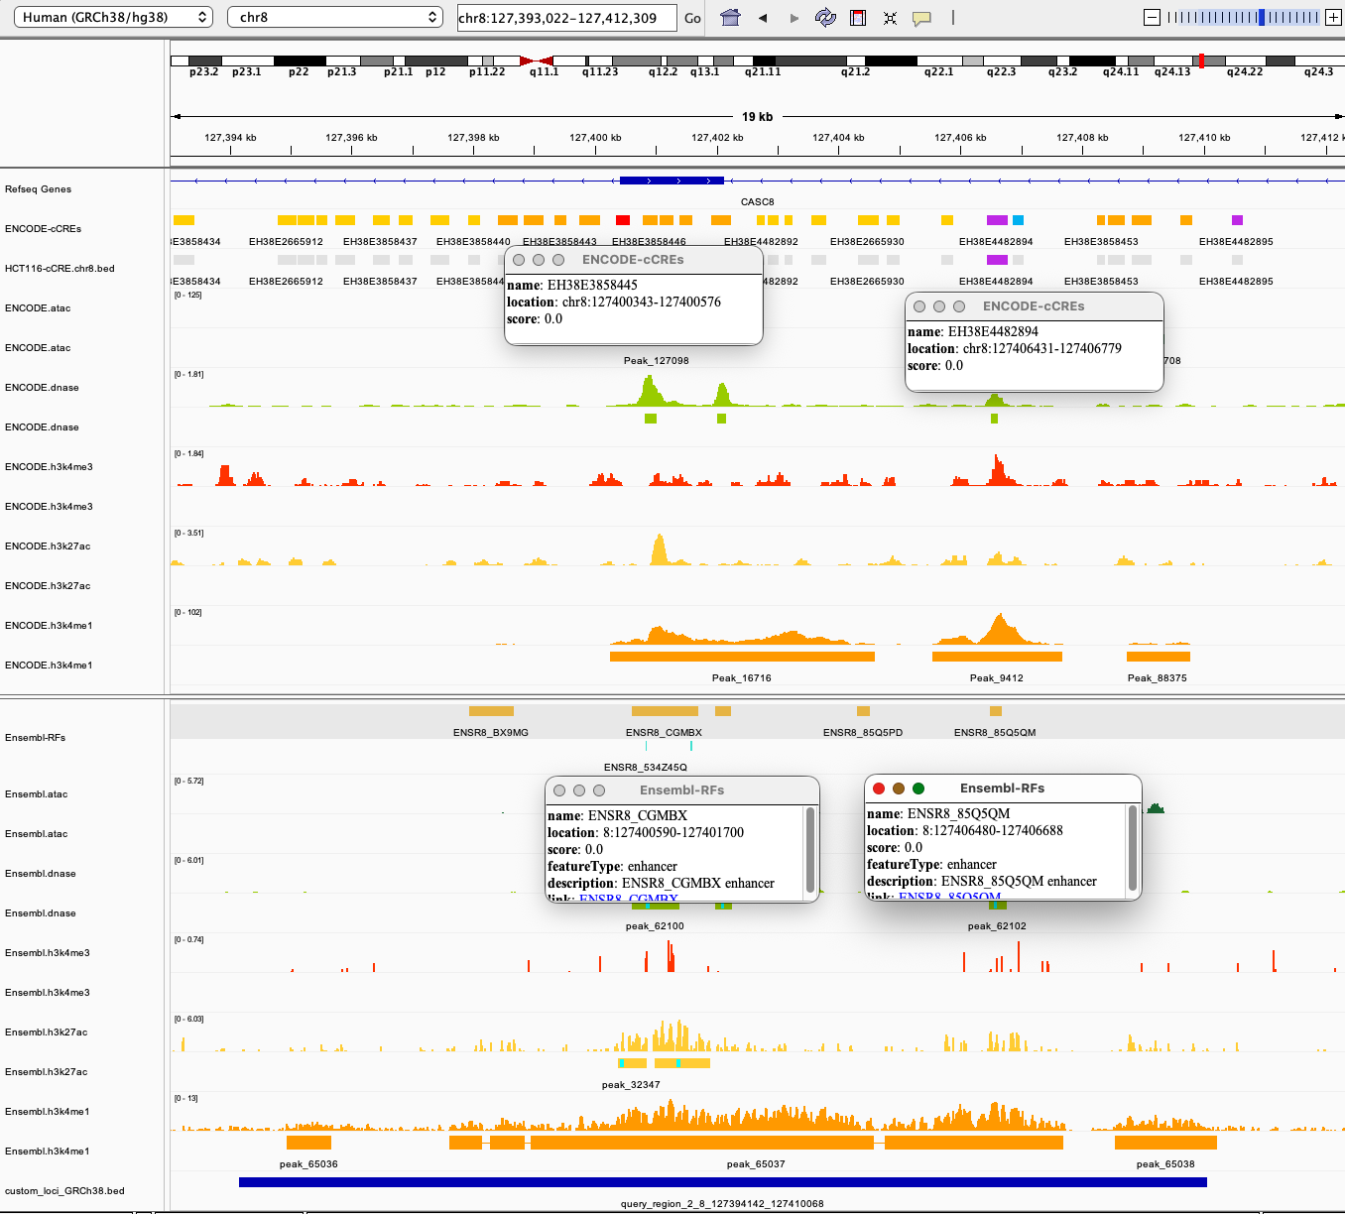
Elements where CRE annotations are discordant

Slide 12
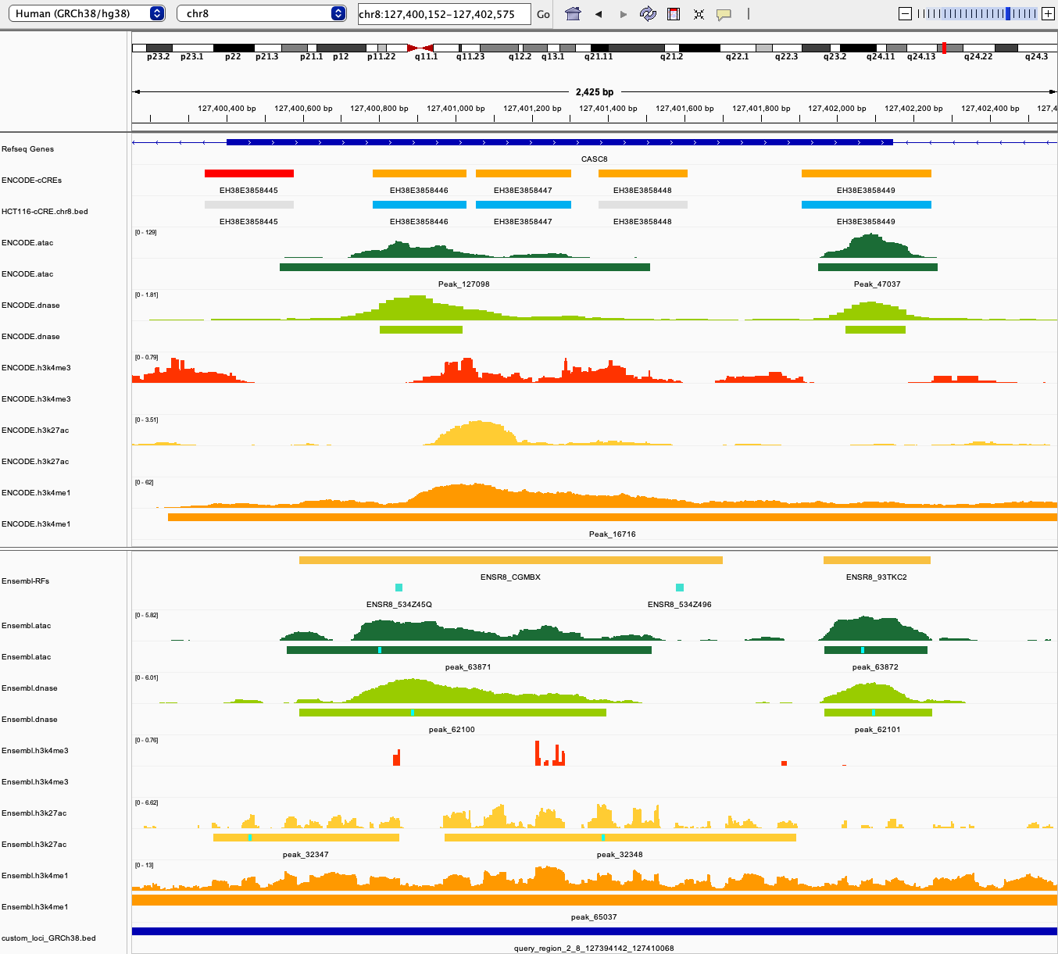
Discrepancy between evidence and annotation
H3K4me1 not used for annotating cCREs as enhancers

Slide 13
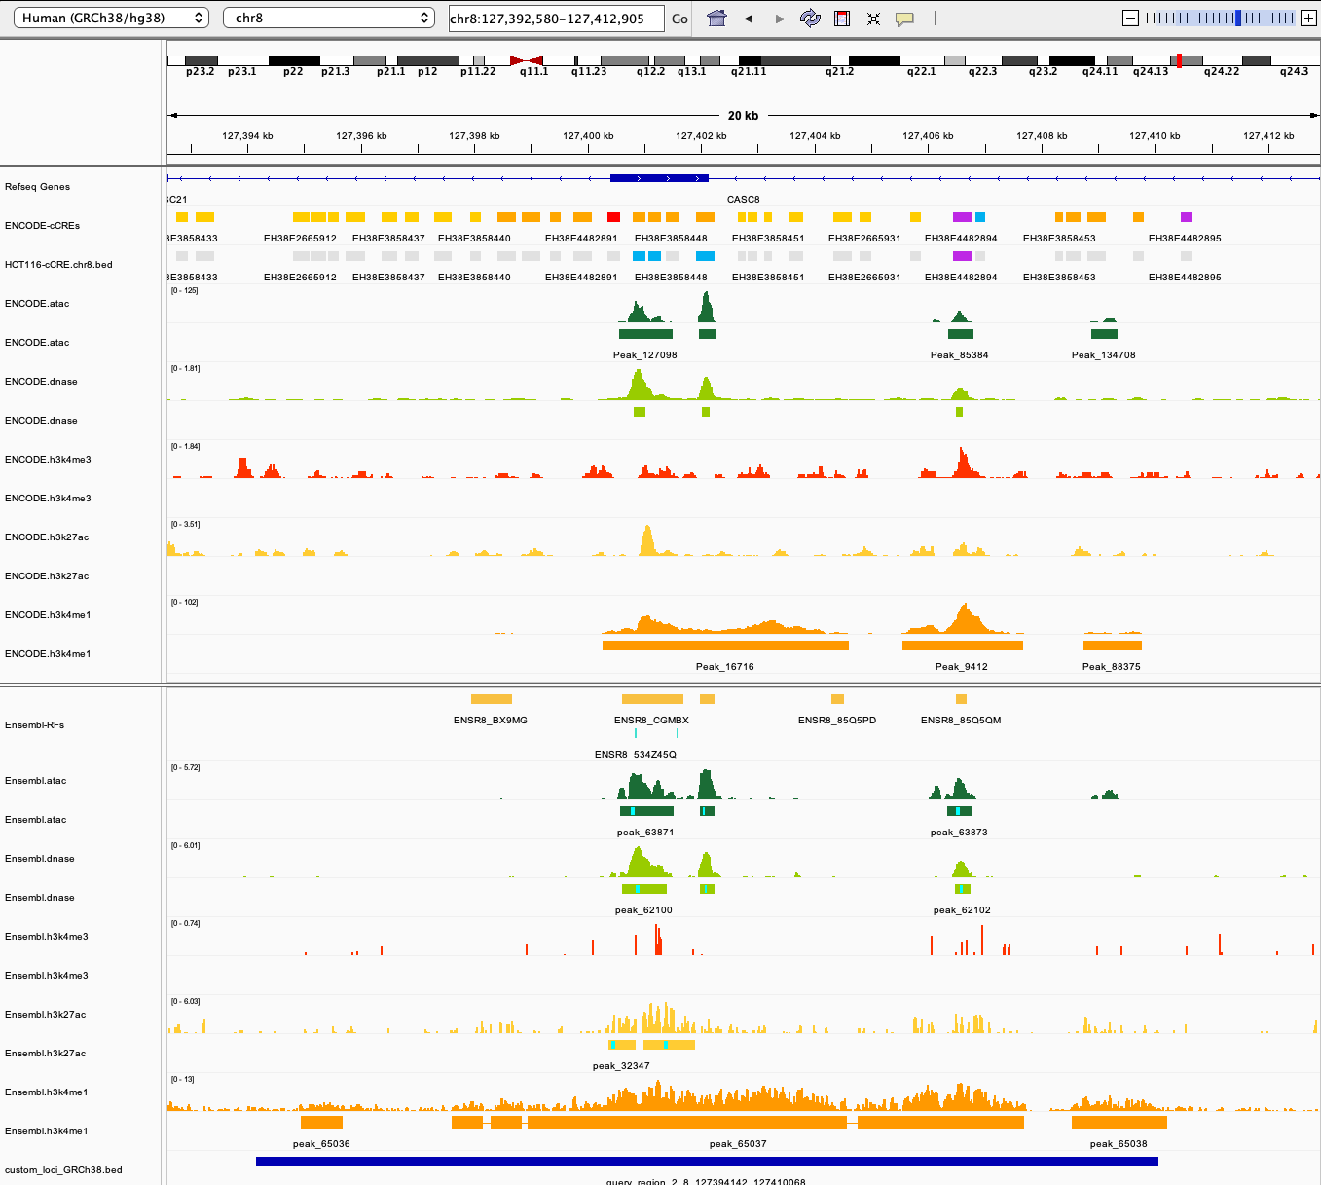
Discrepancy between evidence and annotation
ATAC-seq and H3K4me1 not used for annotating cCREs as enhancers

Slide 14
Missing context example
No epigenomics evidence for these CREs in the explored epigenome

Slide 15
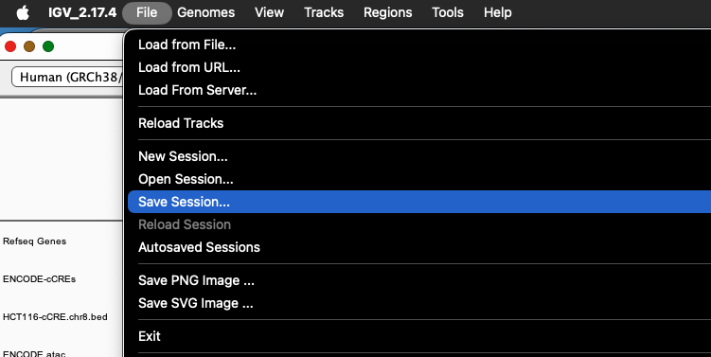
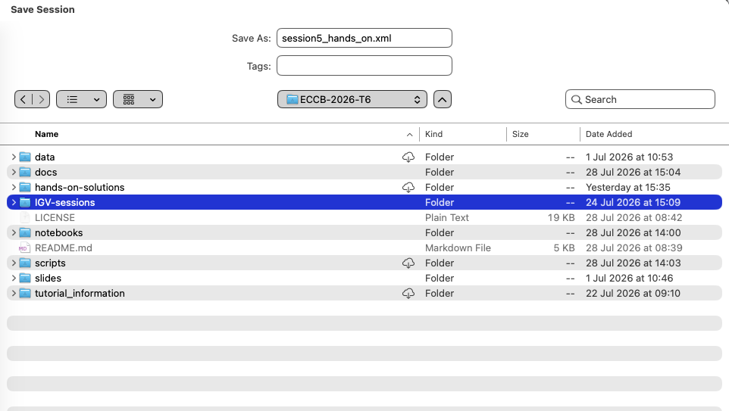
Save session

Slide 16
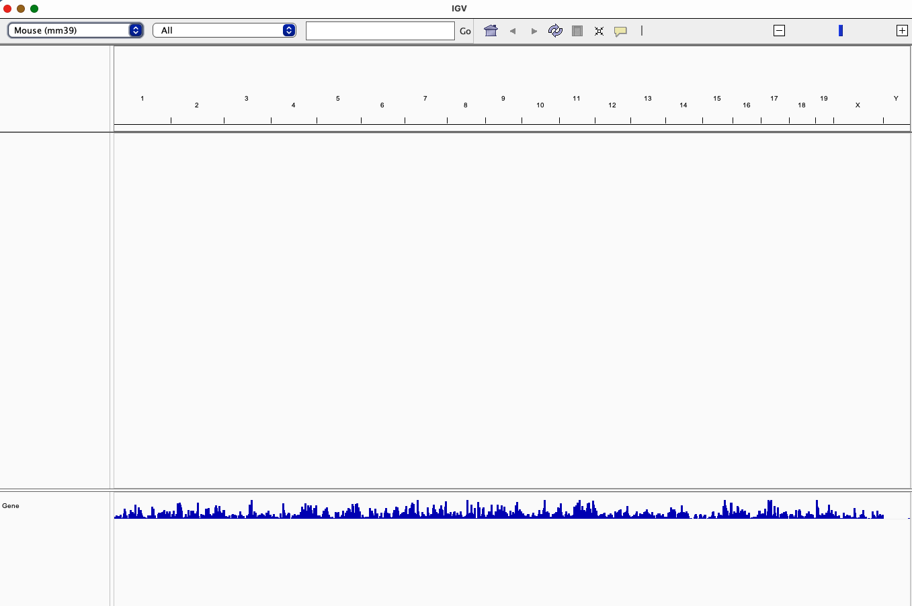
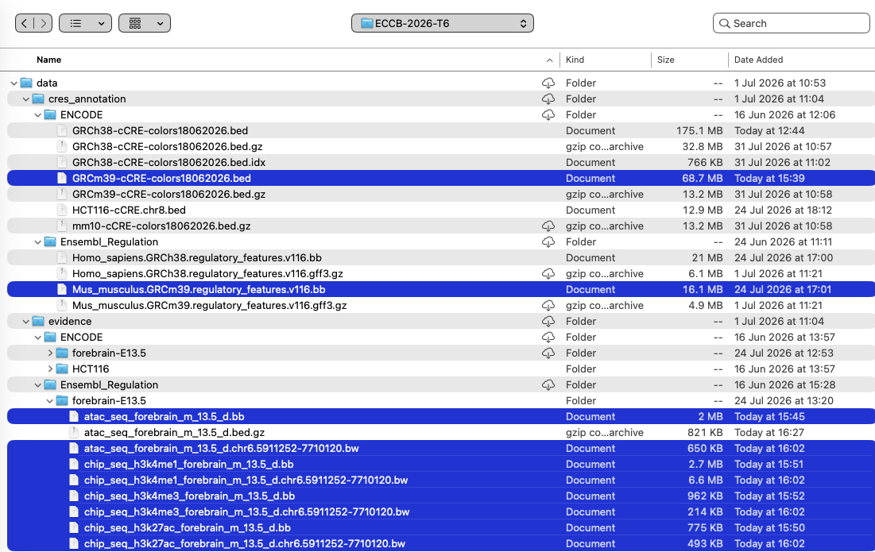
Assignment: Mouse GRCm39 - Ensembl Regulation
Before you start: ENCODE files have been generated using mm10 and Ensembl Regulation files, using GRCm39. You will need different sessions to explore the tracks!

Slide 17
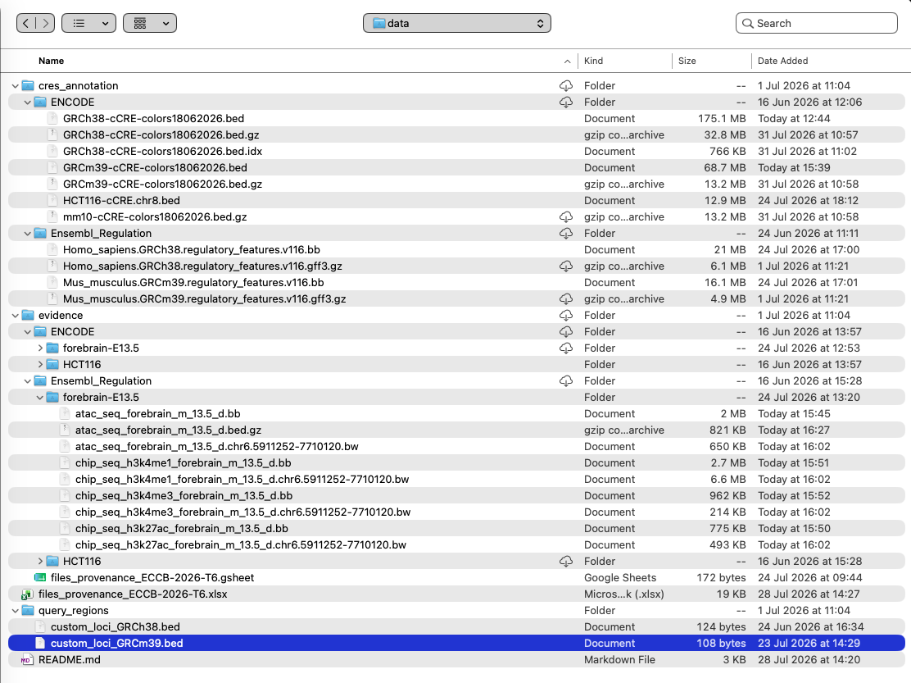
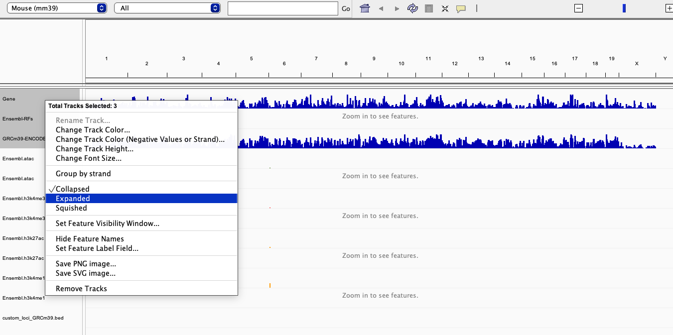
Assignment: Mouse GRCm39 - Ensembl Regulation

Slide 18
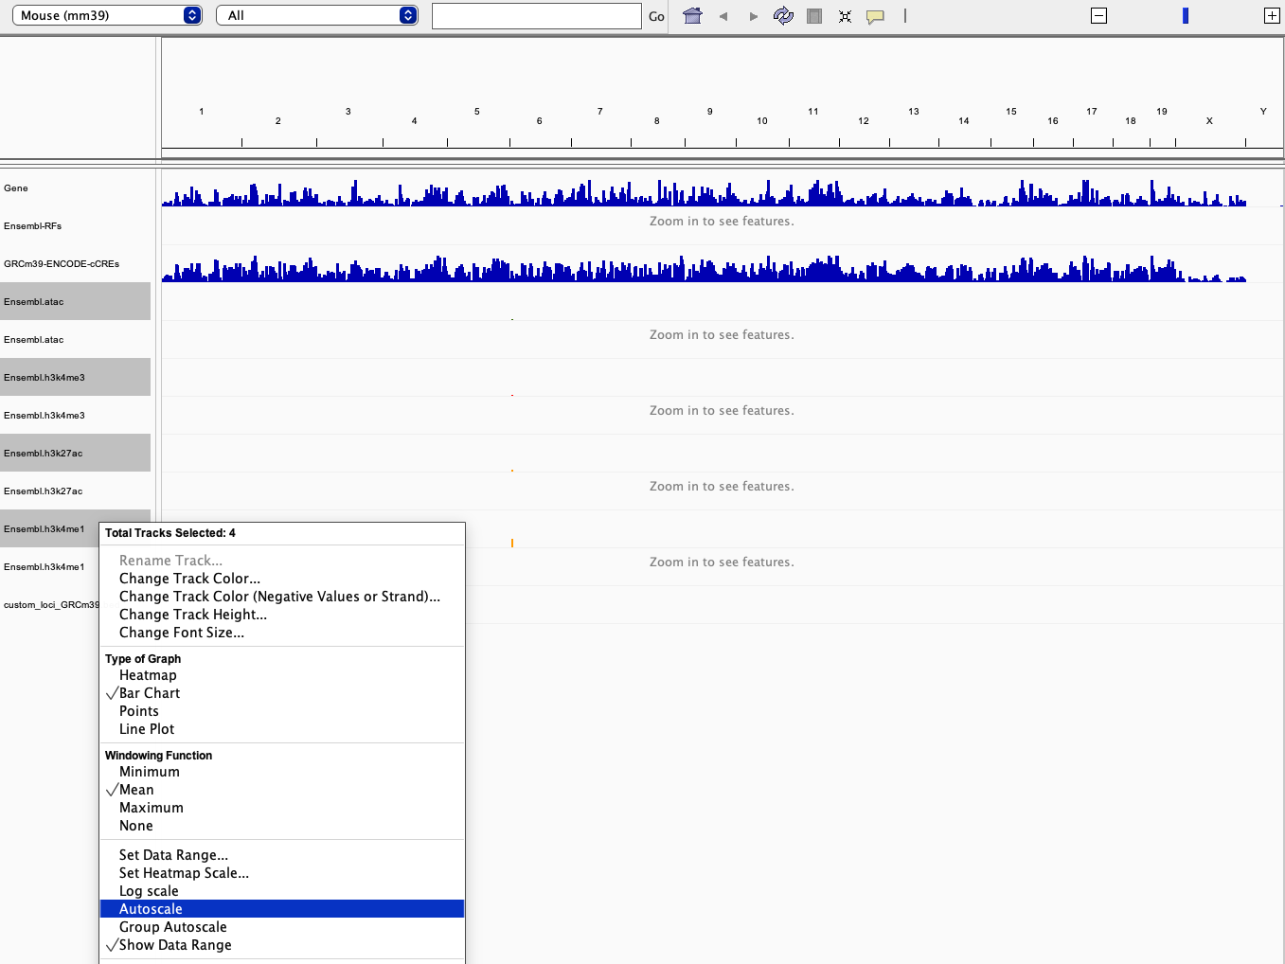
Assignment: Mouse GRCm39 - Ensembl Regulation

Slide 19
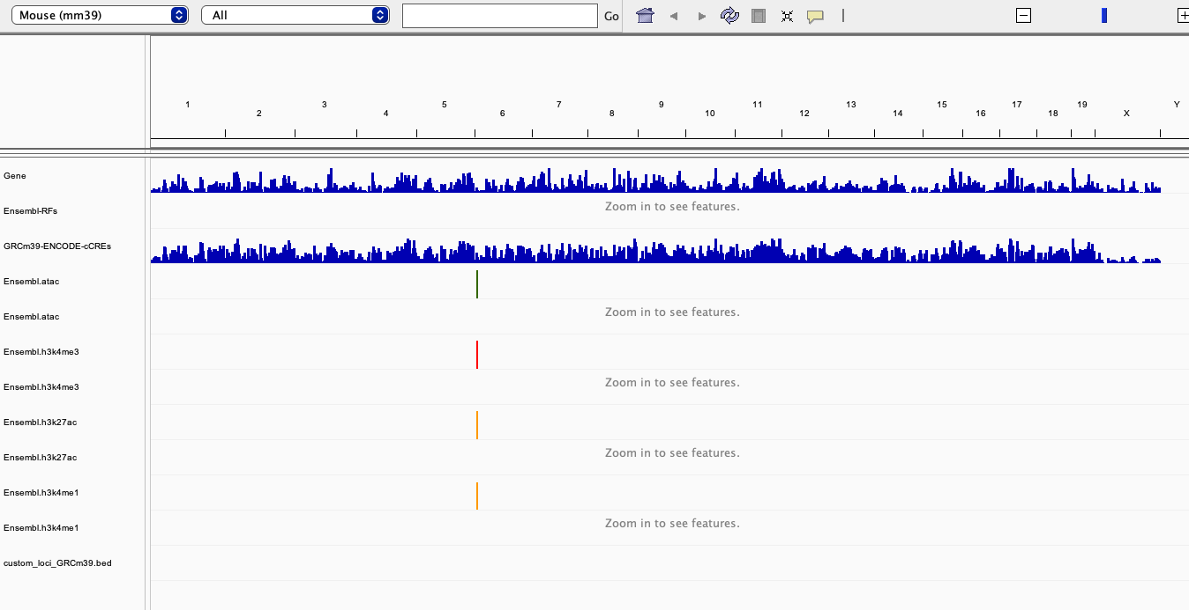
Assignment: Mouse GRCm39 - Ensembl Regulation

Slide 20
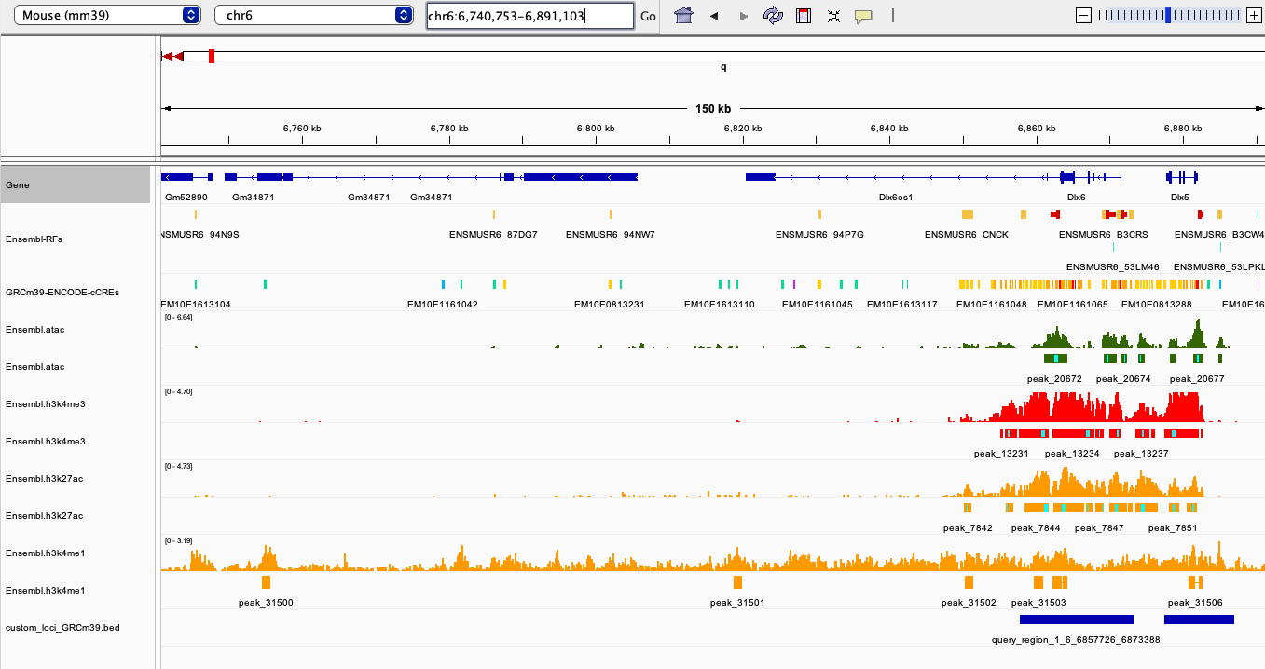
Assignment: Mouse GRCm39 - Ensembl Regulation

Slide 21
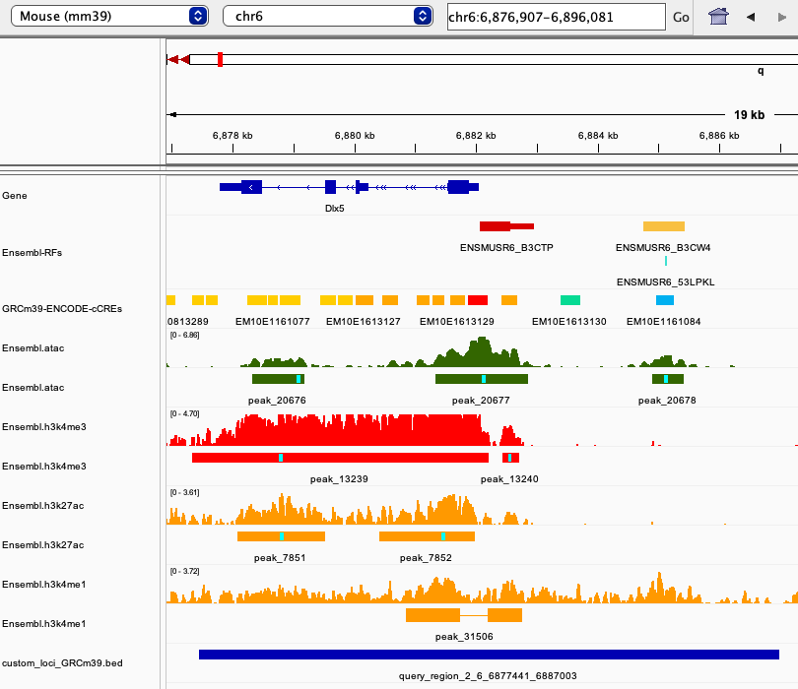
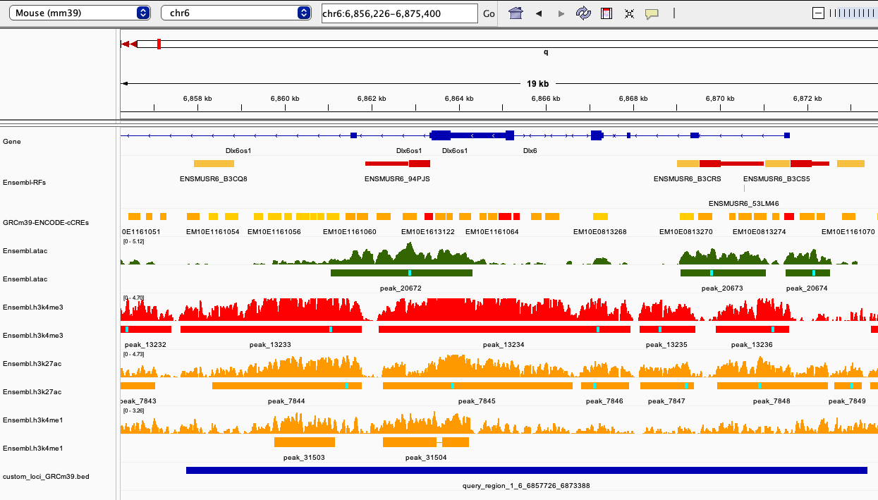
Assignment: Mouse GRCm39 - Ensembl Regulation

Slide 22
Elements where CRE annotations are concordant

Slide 23
Elements where CRE annotations are discordant

Slide 24
Discrepancy between evidence and annotation

